Slide 1
Chapter 1:
Rational Numbers
Lesson 6:
Basic Rules of Algebra
Let’s explore English in Maths
Grade 7

Slide 2
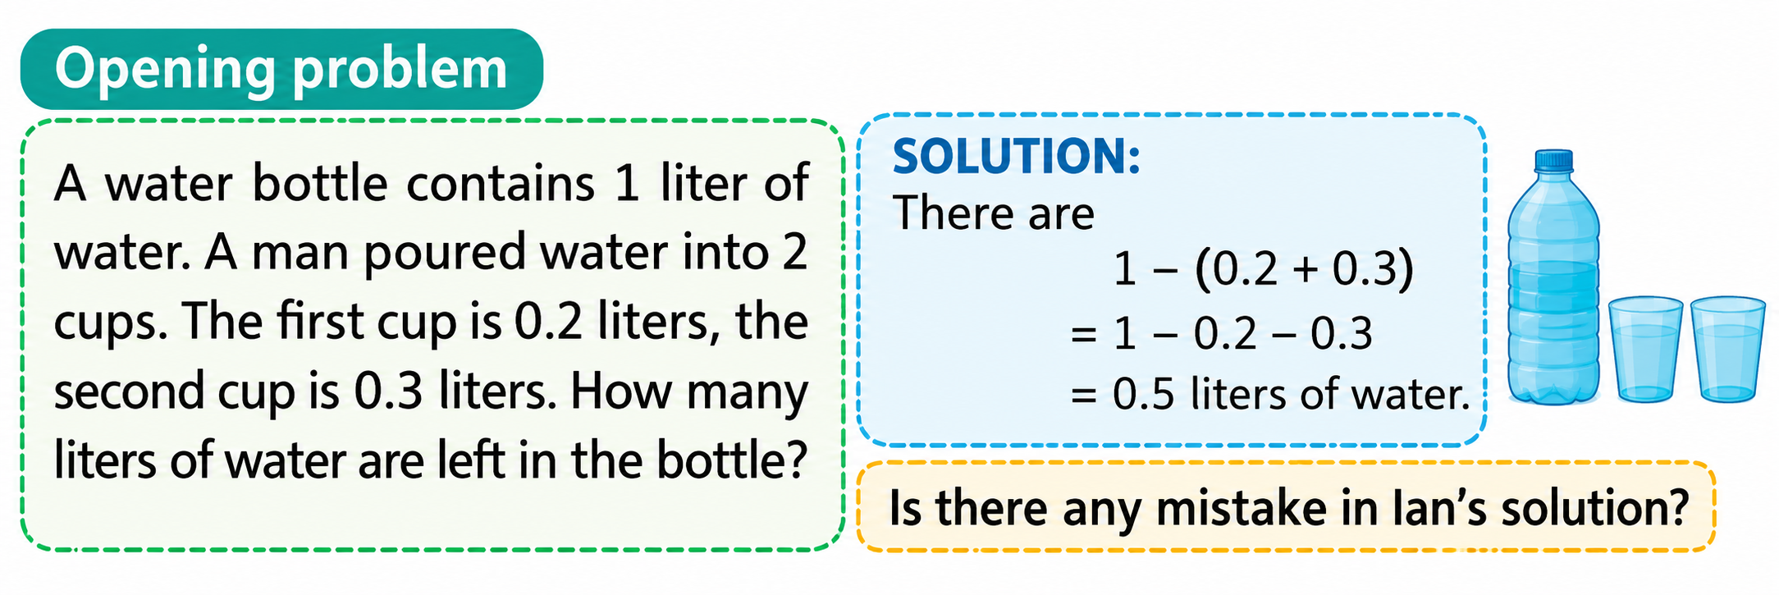

Lead-in
The solution is corrected:
“There are
1 – (0.2 + 0.3)
= 1 – 0.2 – 0.3
= 0.5 liters of water”
There is a mistake in Lan’s solution
Notes:
Step 1: Understand the Problem
"Look at the problem. What shape is the base of the flower pot?"
"What information is given?"
"What do we need to find?"
Expected Student Responses:
Shape: A square.
Given: The side length is $\frac{3}{10} \text{m}$.
Task: Find the area of the base.
Step 2: Recall & Connect
"Who remembers the formula for the area of a square?"
Expected Student Response: $\text{Area}=\text{side}×\text{side}$(or $A=s^{2}$).
Teacher Scaffold:
"Exactly! To find the area of a square, we multiply the side length by itself, which means we square the side length: $A=s^{2}$."
Step 3: Execute & Bridge to New Lesson
"Now substitute the side length $s=\frac{3}{10} \text{m}$into the formula. How do we write that expression?"
Expected Student Response:
$A={\left(\frac{3}{10}\right)}^{2}$(hoặc $\frac{3}{10}×\frac{3}{10}$).
Teacher Guide:
"Let's calculate: $\frac{3}{10}×\frac{3}{10}=\frac{3×3}{10×10}=\frac{3^{2}}{{10}^{2}}=\frac{9}{100}{ \text{m}}^{2}$."
"Notice how ${\left(\frac{3}{10}\right)}^{2}$becomes $\frac{3^{2}}{{10}^{2}}$. This is the power of a rational number!"
Step 4: Model Board Presentation
Solution:
The area of the base of the flower pot is:
$A=s^{2}={\left(\frac{3}{10}\right)}^{2}=\frac{3^{2}}{{10}^{2}}=\frac{9}{100}{\text{ (}\text{m}}^{2}\text{)}$
Answer: $\frac{9}{100}{ \text{m}}^{2}$(or $0.09{ \text{m}}^{2}$)
Step 5: Speaking Practice
(chorus)
"To find the area of the square base, we calculate ${\left(\frac{3}{10}\right)}^{2}$."
"${\left(\frac{3}{10}\right)}^{2}$ equals $\frac{9}{100}$ square meters."

Slide 3
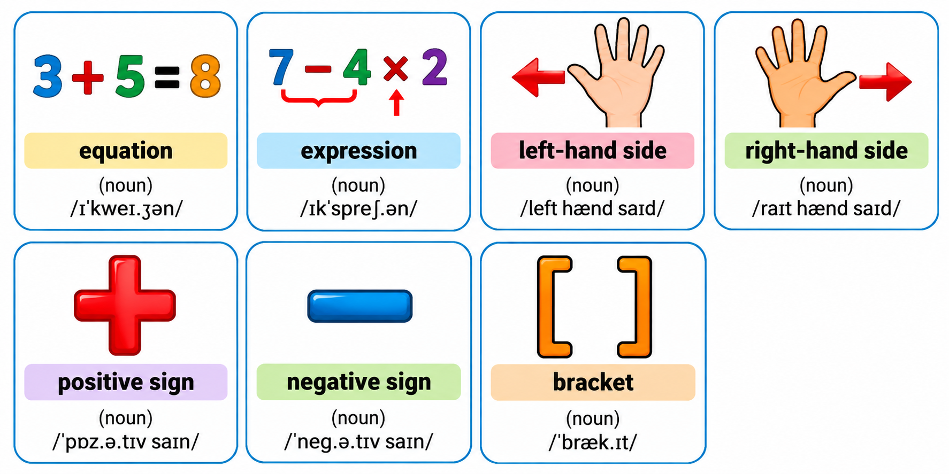
Vocabulary
A mathematical statement that shows two expressions are equal.
Example: 2x + 3 = 9 is an equation.

Slide 4
Vocabulary
A mathematical phrase made up of numbers, variables, and operations, without an equals sign.
Example: 3x − 5 is an algebraic expression.

Slide 5
Vocabulary
The expression to the left of the equals sign in an equation.
Example: In 2x + 3 = 9, 2x + 3 is the left-hand side.

Slide 6
Vocabulary
The expression to the right of the equals sign in an equation.
Example: In 2x + 3 = 9, 9 is the right-hand side.

Slide 7
Vocabulary
The plus sign (+), which indicates addition or a positive value.
Example: In x + 5 = 12, the + is a positive sign.

Slide 8
Vocabulary
The minus sign (−), which indicates subtraction or a negative value.
Example: In 3x − 7 = 8, the − is a negative sign.

Slide 9
Vocabulary
A pair of symbols used to group numbers, variables, or expressions.
Example: In 2(x + 3), (x + 3) is a bracketed expression.

Slide 10
Review

Slide 11
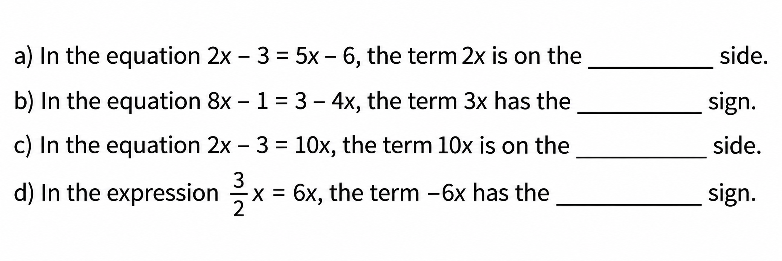
A. Vocabulary
Fill in the blanks, using the words: left-hand, right-hand, negative, postitive
left-hand
postitive
right-hand
negative

Slide 12
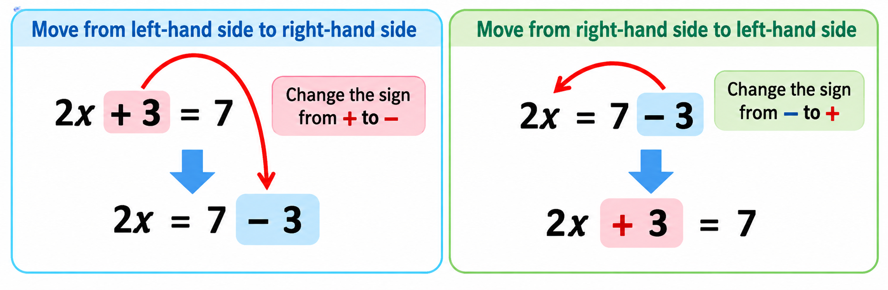
Maths Corner
What is the rule for changing sides?
In an equation, if we change a term from left-hand side to right-hand side or vice versa, we must change its sign.

Slide 13
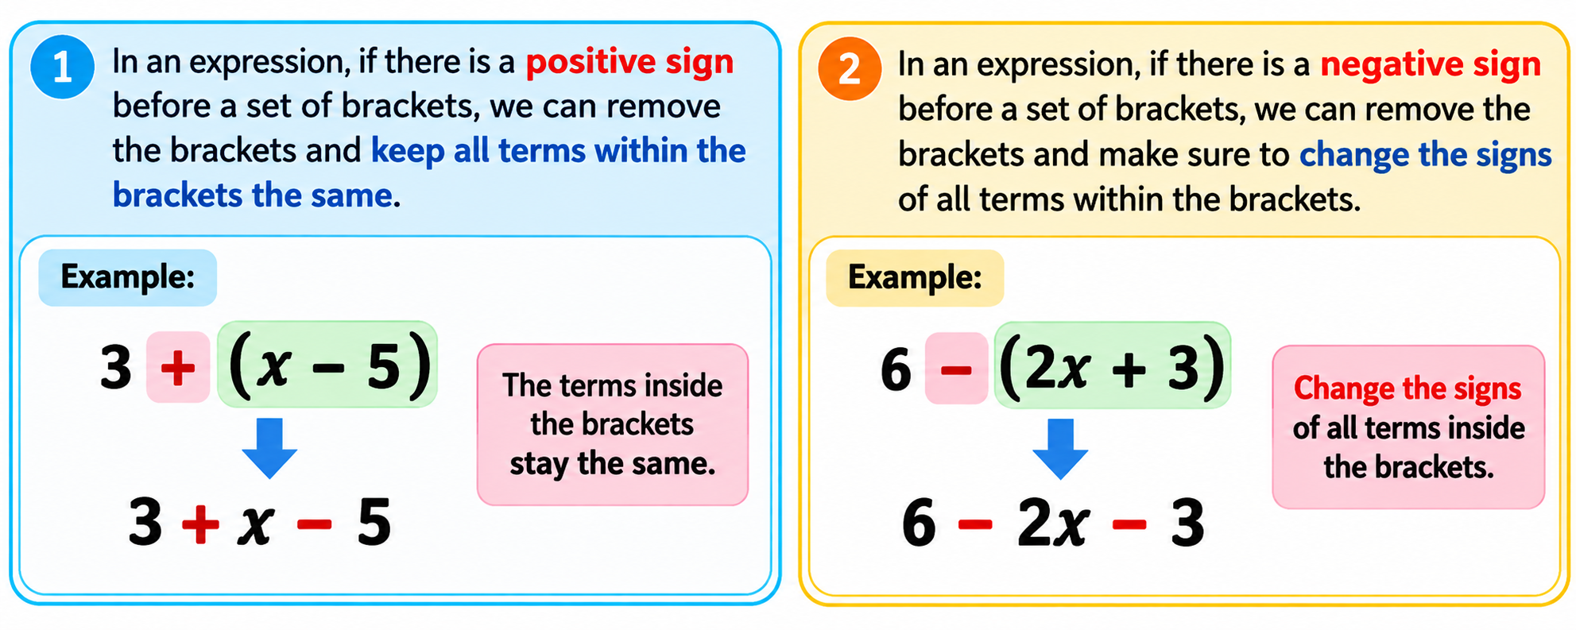
Maths Corner
What is the rule for removing brackets?
In an expression, if there is a positive sign before a set of brackets, we can remove the brackets and keep all terms within the brackets the same.
In an expression, if there is a negative sign before a set of brackets, we can remove the brackets and make sure to change the signs of all terms within the brackets.

Slide 14




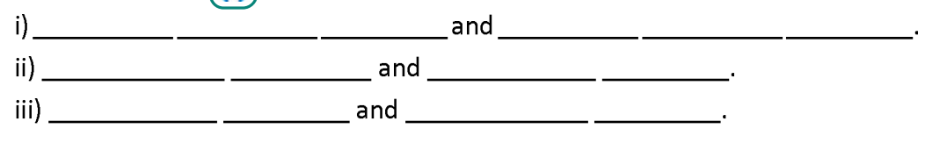
B. Pronunciation
a. Listen to the words and focus on the underlined letters
b. Circle the correct words
c. Listen and write
Left-hand side
Right-hand side
Negative sign
Positive sign
Change side
Change sign

Slide 15
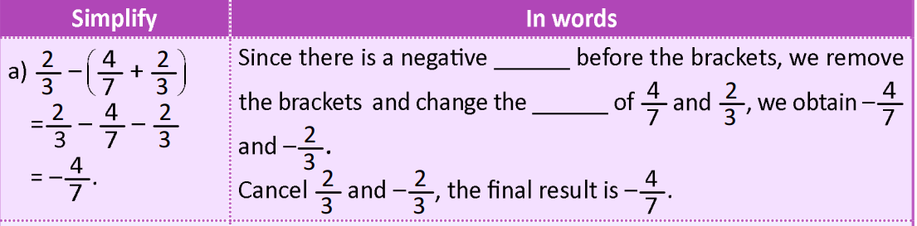
C. Writing
Fill in the blanks to express the process of the following operations in words.
sign
signs

Slide 16
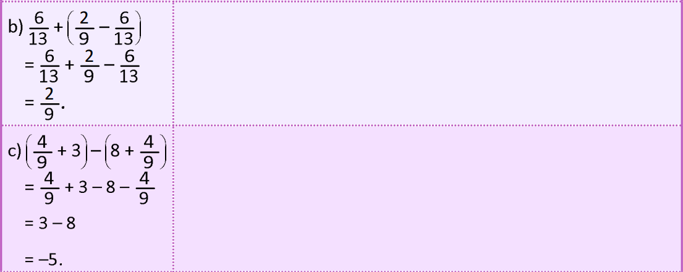
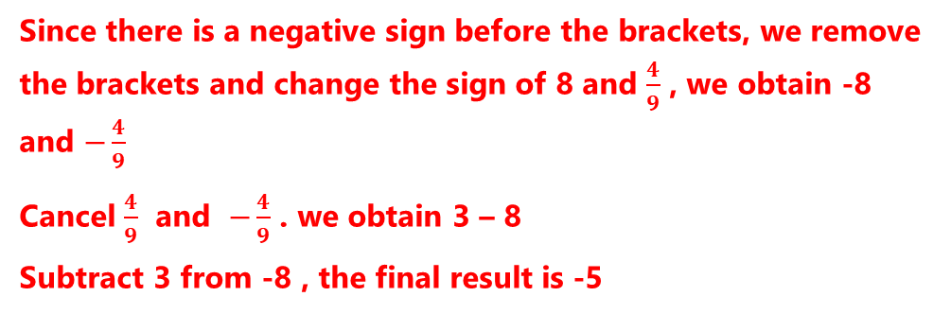
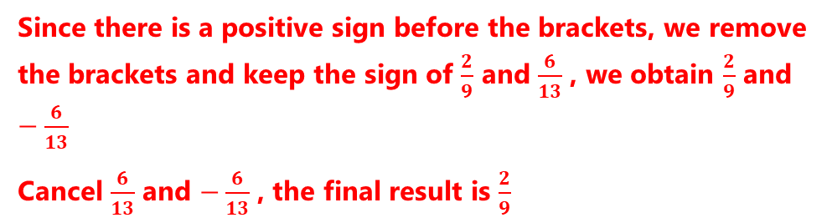
C. Writing
Fill in the blanks to express the process of the following operations in words.
Since there is a positive sign before the brackets, we remove the brackets and keep the sign of $\frac{2}{9}$ and $\frac{6}{13}$ , we obtain $\frac{2}{9}$ and $−\frac{6}{13}$
Cancel $\frac{6}{13}$ and $−\frac{6}{13}$ , the final result is $\frac{2}{9}$
Since there is a negative sign before the brackets, we remove the brackets and change the sign of 8 and $\frac{4}{9}$ , we obtain -8 and $−\frac{4}{9}$
Cancel $\frac{4}{9}$ and $−\frac{4}{9}$ . we obtain 3 – 8
Subtract 3 from -8 , the final result is -5

Slide 17
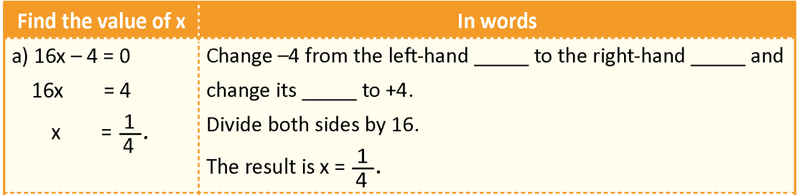
D. Writing
Fill in the blanks to express the process of the following operations in words
side
side
sign

Slide 18
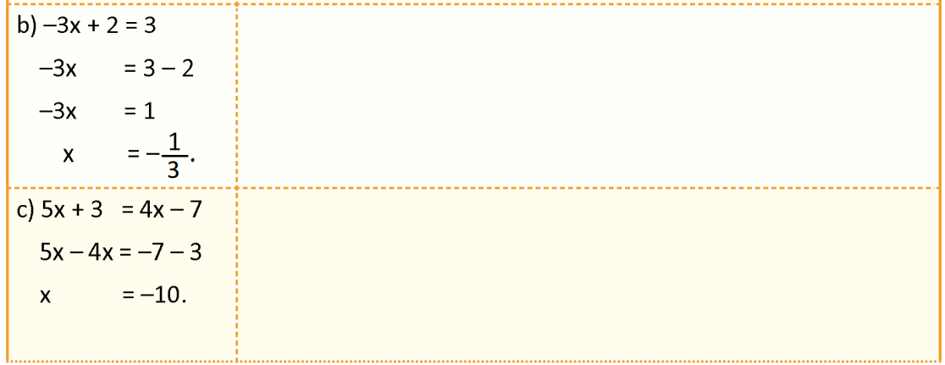
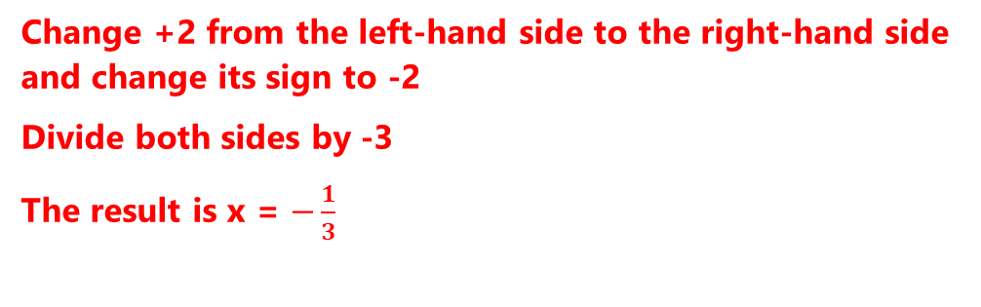
D. Writing
Fill in the blanks to express the process of the following operations in words
Change +2 from the left-hand side to the right-hand side and change its sign to -2
Divide both sides by -3
The result is x = $−\frac{1}{3}$
Change +3 from the left-hand side to the right hand side and change its sign to -3 . Change +4x from the right-hand side to the left-hand side and change its sign to -4x
Subtract -4x from 5x, we obtain x. Subtract -3 from -7, we obtain -10. The result is x = -10

Slide 19
Consolidation
Vocabulary: equation, expression, left-hand side, right-hand side, positive sign, negative sign.
Know equation, expression, left-hand side, right-hand side, positive sign, negative sign, and how to change sides and remove brackets.
Sentence Patterns:
+ In an equation, if we change a term from left-hand side to right-hand side or vice versa, we must change its sign.
Prepare the next lesson.

Slide 20
Thanks!
“Find the unknown value, unlock the whole story.”

